Slide 1
RLL-Project ChilternOak Furniture Group-4

Slide 2
Group Members:
Emp Id:
Amruta J Nagathan
Diwakar Ramesh
Farhan Belgaumi
Gaurav X(Team Lead)
Nayak Suresh
Puttuboina Nagasahithi
Santhakumar Ekambaram
Vishvesh Aralikatti
2580229
2580273
2580293
2579955
2580082
2580029
2580271
2580178

Slide 3
Agenda
Introduction
Objective & Scenario Functionalities
Java
Selenium
Cucumber
TestNG
Data Driven
Listeners & IRetryAnalyser
POM Framework
Extent Reports
Jira
Outputs
Conclusion

Slide 4
Introduction
In this project, our focus revolves around exploring and evaluating the diverse functionalities of the Chilternoak Furniture website.
We initiated the testing phase by creating manual test cases, utilizing tools and frameworks such as Selenium, TestNG, and Cucumber.
In our testing process, we improved reporting using extent reports and logs. To address failed test cases, we used IRetryAnalyser and took screenshots for analysis.
We also applied a data-driven concept for reading data. Jira was employed for managing the test lifecycle in this project.

Slide 5
Objective
Create a test script to automate the test scenario and generate the reports for e-Commerce website https://www.chilternoakfurniture.co.uk/.
Using automation script all the pages of the e-commerce website are tested systematically, and transactions are entirely validated.
Testing the website can provide a seamless, reliable and user-friendly experience.

Slide 6
Scenarios Functionalities
Sign Up: Create a new account by entering your details. Verify your email to get started.
Login: Log in with your username or email, and password. Stay logged in for convenience.
Search: Find what you need by typing keywords. Refine results with advanced filters.
Subscribe: Get newsletters and updates by subscribing. Choose what interests you.
Cart: Add products you like, adjust quantities, and easily check out when ready.
Check Out: Enter your shipping details (Like FName, LName……..) and proceed to payment.
Filters: Find products easily with category and price filters. Customize filters for your preferences.
Contact Us: Use the contact form for inquiries or feedback. Customer support is ready to assist.

Slide 7
JAVA
Technologies Used:
What is java?
Java is a Programming language and a platform.
Platform: Any hardware or software environment in which a program runs, known as platform. Since Java has its own Runtime Environment, it is called platform.

Slide 8
Where it is used ? TYPES
Desktop Applications
Web Applications
Enterprise Applications
Mobile
Embedded System
Robotics
Games etc.,
Standalone Application
Web Application
Enterprise Applications
Mobile Application

Slide 9
Features: DISADVANTAGES:
Simple 1. Performance
Object-Oriented 2. Memory consumption
Platform independent 3. Less machine interactive
Secured 4. Cost
Robust 5. Garbage collection
Portable
Dynamic
Multi-threaded etc.,

Slide 10
SELENIUM
WHAT IS SELENIUM?
Selenium is a powerful open-source framework commonly used for automating web applications.
It provides a way for software developers and testers to write scripts in various programming languages (such as Java, Python, C#, Ruby, and others) to automate interactions with web browsers.
Features:
1. Browser Automation
2. Testing Framework Integration

Slide 11
Advantages of Selenium
Open Source: Selenium is open-source, which means it is freely available for use, and its source code can be modified and extended by the community.
Platform Independence: Selenium is platform-independent and can be used on various operating systems like Windows, macOS, and Linux.
Integration with Testing Frameworks: Selenium can be integrated with popular testing frameworks like JUnit, TestNG, and others, providing additional features for organizing and managing test cases.
Multiple Programming Language Support: Selenium supports multiple programming languages like Java, Python, C#, Ruby, and others, providing flexibility for developers who can use their preferred language.

Slide 12
Uses of selenium web application
Automated Testing:
Selenium is widely used for automated testing of web applications. It allows testers to write scripts to simulate user interactions, perform actions, and verify expected outcomes.
Accessibility Testing:
Selenium can be used in combination with other tools to perform accessibility testing, ensuring that web applications are accessible to users with disabilities.
Web Scraping:
Selenium can be used for web scraping, extracting data from websites for various purposes. Developers can use it to automate the process of navigating through web pages, filling out forms, and extracting desired information.
Performance Testing:
Selenium can be used to automate performance testing scenarios by simulating a large number of users interacting with a web application simultaneously. This helps in identifying performance bottlenecks and optimizing web application performance.

Slide 13
CUCUMBER
Cucumber is a widely used open-source tool for Behavior-Driven Development (BDD) in software testing.
Cucumber is a BDD framework that allows tests to be written in natural language, making them more readable and understandable.
Cucumber uses a syntax called “Gherkin”. Gherkin uses plain text with keywords like Given, When, Then, And, & But to describe test scenarios.
It encourages collaboration between technical and non-technical stakeholders in the software development process.
Cucumber is compatible with popular software platforms like Selenium, Ruby, and others.

Slide 14
Advantages
Human-Readable Syntax: The language used in Cucumber, is designed to be easily readable by both technical and non-technical stakeholders
Reusable Steps: Steps written in Cucumber can be reused, reducing redundancy and making tests easier to maintain.
Clear Test Reporting: Cucumber provides clear and concise test reports, making it easier to identify which scenarios passed or failed.
Support for Data Tables and Scenario Outlines: Cucumber allows the use of data tables and scenario outlines, providing a way to parameterize tests and execute them with different sets of data.
Support for Parallel Execution: Cucumber supports parallel test execution, which allows teams to run tests concurrently, reducing overall test execution time.

Slide 15
USE CASE IN OUR PROJECT:
Feature Files: Feature files contain scenarios, steps, and examples for testing different aspects of the application and test scenarios are written in plain text files with a .feature extension.
Scenario Outline: This helps in creating data-driven tests with different input combinations.
Background: Cucumber feature files can include a Background section, defining preconditions that apply to all scenarios in the file.
Step Definitions: Step definitions map Gherkin language steps to actual code that performs the actions and verifications.
Parameterization: The variables are passed as arguments to the corresponding step definition methods.
Integration with Page Objects Model: Step definitions interact with Page Objects to perform actions on the web elements of the ChilternOak website.

Slide 16
Introduction To TestNG
TestNG (Test Next Generation) is a testing framework inspired by JUnit and NUnit, designed for simplifying test configuration and parallel execution.
Developed by Cédric Beust, TestNG offers powerful features for testing Java applications and provides a more flexible and easily configurable testing environment.
The design goal of TestNG is to cover a wider range of test categories: unit, functional, end-to-end, integration, etc., with more powerful and easy-to-use functionalities
TestNG makes automated tests more organized, readable, maintainable, effective, and user-friendly. Its high-end annotations make it simple to scale while executing cross-browser testing across multiple devices, browsers, and their versions.

Slide 17
Advantages of TestNG
Parallel Execution: TestNG supports parallel test execution, allowing multiple tests to run concurrently, reducing overall test suite execution time.
Annotations: TestNG leverages annotations like @Test, @BeforeMethod, and @AfterMethod, providing a structured and readable way to define test methods and setup/teardown procedures.
Data-Driven Testing: TestNG supports data-driven testing, enabling the use of external data sources (Excel, CSV, XML) for testing multiple data sets without modifying test code.
Test Dependencies: TestNG allows the definition of dependencies between test methods, ensuring a specific order of test execution.

Slide 18
Uses of TestNG in Web Application Testing
Selenium Integration: TestNG seamlessly integrates with Selenium, a popular web application testing tool. It provides better control over test execution and reporting.
Cross-Browser Testing: TestNG facilitates cross-browser testing by allowing the creation of test suites that run the same set of tests across different browsers and environments.
Parameterization: TestNG supports parameterization, enabling the dynamic passing of parameters to test methods, making it efficient for testing various scenarios in web applications.
Reporting: TestNG generates detailed HTML reports, providing insights into test execution results, making it easier to identify and debug issues in web application testing.

Slide 19
Data Driven
Data Driven Testing:
Data Driven Testing is a software testing method in which test data is stored in table or spreadsheet format. Data driven testing allows testers to input a single test script that can execute tests for all test data from a table and expect the test output in the same table. It is also called table-driven testing or parameterized testing.
Data Driven Framework:
Data Driven Framework is an automation testing framework in which input values are read from data files and stored into variables in test scripts. It enables testers to build both positive and negative test cases into a single test. Input data in data driven framework can be stored in single or multiple data sources like .xls, .xml, .csv and databases.

Slide 20
Why Data Driven Testing?
Data Driven Testing is important because testers frequently have multiple data sets for a single test and creating individual tests for each data set can be time-consuming. Data driven testing helps keeping data separate from test scripts and the same test scripts can be executed for different combinations of input test data and test results can be generated efficiently.
Example:
If we want to test the login system with multiple input fields with 50 different data sets.
To test this, you can take following different approaches:
Approach 1) Create 50 scripts one for each dataset and runs each test separately one by one.
Approach 2) Manually change the value in the test script and run it several times.
Approach 3) Import the data from the excel sheet. Fetch test data from excel rows one by one and execute the script.
In the given three scenarios first two are laborious and time-consuming. Therefore, it is ideal to follow the third approach. Thus, the third approach is nothing but a Data-Driven framework

Slide 21
Advantages and Disadvantages
Advantages
Disadvantages
Allows to test application with multiple sets of data values during Regression testing
Actions and Functions can be reused in different tests.
Data-driven testing can perform any phase of the development.
Data validation is a time-consuming task when testing large amount of data.
Maintenance is a big issue as large amount of coding needed for Data-Driven testing.
High-level technical skills are required. A tester may have to learn an entirely new scripting language.

Slide 22
TestNG Listener
In TestNG, a listener is an interface that allows the customization of test execution behaviour.
TestNG listeners are used to perform actions or respond to events that occur during test execution lifecycle.
These events can include the start or completion of a test, the success or failure of a test method.
Listener is not a class in TESTNG -> it is an Interface

Slide 23
TestNG Listener
The most common used TestNG listener:
ITestListener :
Purpose: Handles events related to the entire test suite
Usage: Allows you to respond to suite-level such as the start and finish of a test suite, test, or configuration method.
The methods of ITestListener are:
Onstart(), onTestStart(), onTestSuccess(), onTestFailure(), onTestSkipped(), onTestFailedButWithinSuccessPercentage(), onTestFailedwithTimeout(), OnFinish()
And these method are method over riding
We can execute listener in xml file by giving @listener(class name)

Slide 24
IRetryAnalyzer
An ‘IRetryAnalyzer’ in TestNG is an interface used to implement custom retry logic for failed test cases.
When a test method annotated with ‘@Test’ fails, the ‘IRetryAnalyzer’ is invoked to decide whether the test should be retried or marked as a final failure.
We need to create a class that implements this interface and override the ‘retry’ method to specify the retry behaviour based on our requirements.

Slide 25
Introduction to Page Object Model (POM)
Definition:
POM is a design pattern used in test automation to create a clear separation between the structure of the web application and the tests, providing a more maintainable and scalable approach.
Page Objects: Components representing the pages of the application, encapsulating the interactions and elements on each page.
Test Methods: Methods in the test code that interact with the Page Objects to perform actions and validations.
Advantages:
Code Reusability: POM promotes the reuse of Page Objects across multiple tests.
Enhanced Maintainability: Changes in the UI are isolated to the corresponding Page Object, reducing maintenance effort.

Slide 26
Benefits of Implementing POM
Improved Readability:
POM enhances code readability by structuring interactions with web elements in separate Page Objects, making test scripts more understandable.
Reduced Redundancy:
POM minimizes code duplication by centralizing the maintenance of locators and interactions within the Page Objects.
Easy Collaboration:
POM facilitates collaboration between developers and testers by providing a clear interface for test script development.
Enhanced Debugging:
If a test fails, POM isolates the issue to a specific Page Object, making debugging and issue resolution more straightforward.
Scalability:
POM supports the scalability of test suites, allowing for the addition of new tests and features without extensive code modifications.

Slide 27
POM in Our Project
Page Objects in Use:
What We Do: We use Page Objects to represent each web page in our testing.
Example: For instance, we have a LoginPage Page Object for the login page.
Real Testing Scenario:
How We Test: We'll walk through a simple test scenario to show how Page Objects are used.
Interaction: This includes interacting with elements and validating results.
Adaptability to Changes:
Handling Changes: POM helps us easily adapt to changes in the UI.
Example: If a button's location changes, we only update the Page Object, minimizing impact.

Slide 28
EXTENT REPORTS
EXTENTREPORTS LIBRARY:
Extent Reports is an open-source reporting library useful for test automation. These reports are HTML documents that depict results as pie charts. They also allow the generation of custom logs, snapshots, and other customized details.
Once an automated test script runs successfully, testers need to generate a test execution report.
BENEFITS OF USING EXTENT REPORTS:
They can be integrated with TestNG and Junit.
If required, screenshots can be captured and displayed for each step in a test.
They allow testers to track multiple test case runs in a single test suite
They show the time needed for test execution
They can be customized to graphically represent each step in a test.
All methods on ExtentReports are multi-thread safe.

Slide 29
JIRA
What is jira:
Jira is a very powerful project management tool and some of the main part of jira is projects, issues and workflow.
We can defining goals and setting up team collaboration and add all your teammates in a single project.
Use of jira:
We use Jira's planning features for effective project management. We use dashboard for tracking and monitoring.
Integrations with Other Tools.
We integrate our jira with zephyr scale with the help of zephyr scale we import our all the. Manual test cases and assign everyone according to their scenarios. And after assigning everyone work on that zephyr scale.
Features:
We create daily sprint in jira, set daily goals and issues in our jira.
In board you can check daily activity of any users whom you assign tasks like they did it complete or its in progress now.
In list section you can have a list of all the activity where status of every activity show here.

Slide 30
Why Jira?
Jira provides a robust project management methodology specifically designed for software development.
It allows full customization of team management projects, catering to the unique needs of each team.
Jira equips users with tools for estimating, reporting, and measuring workflow and daily activities.
Teams can easily utilize Jira for managing regular development tasks, bug tracking, and product management.

Slide 31
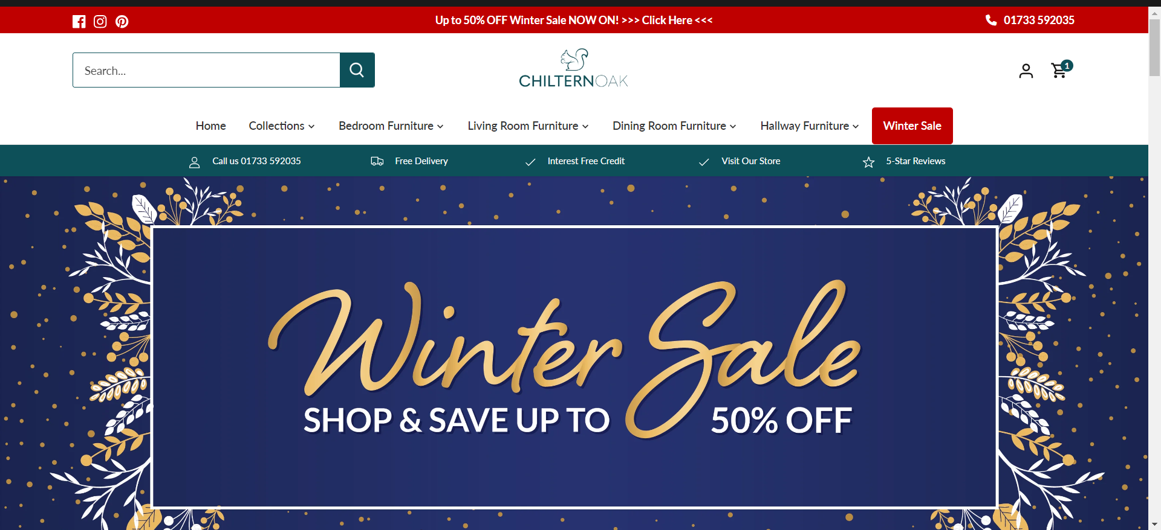
ScreenShots

Slide 32
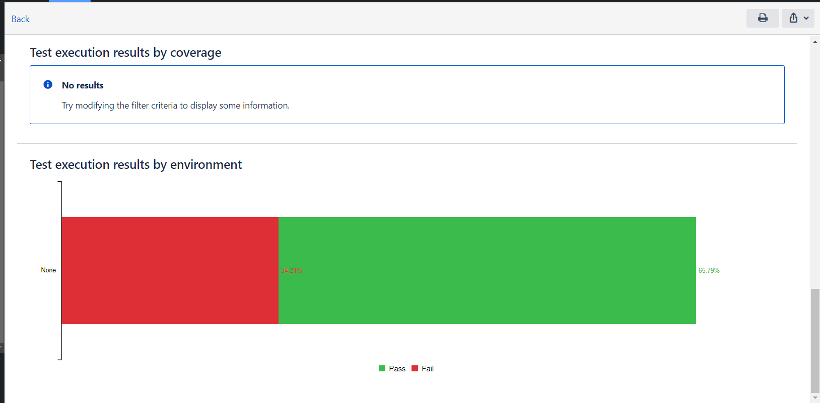

Slide 33
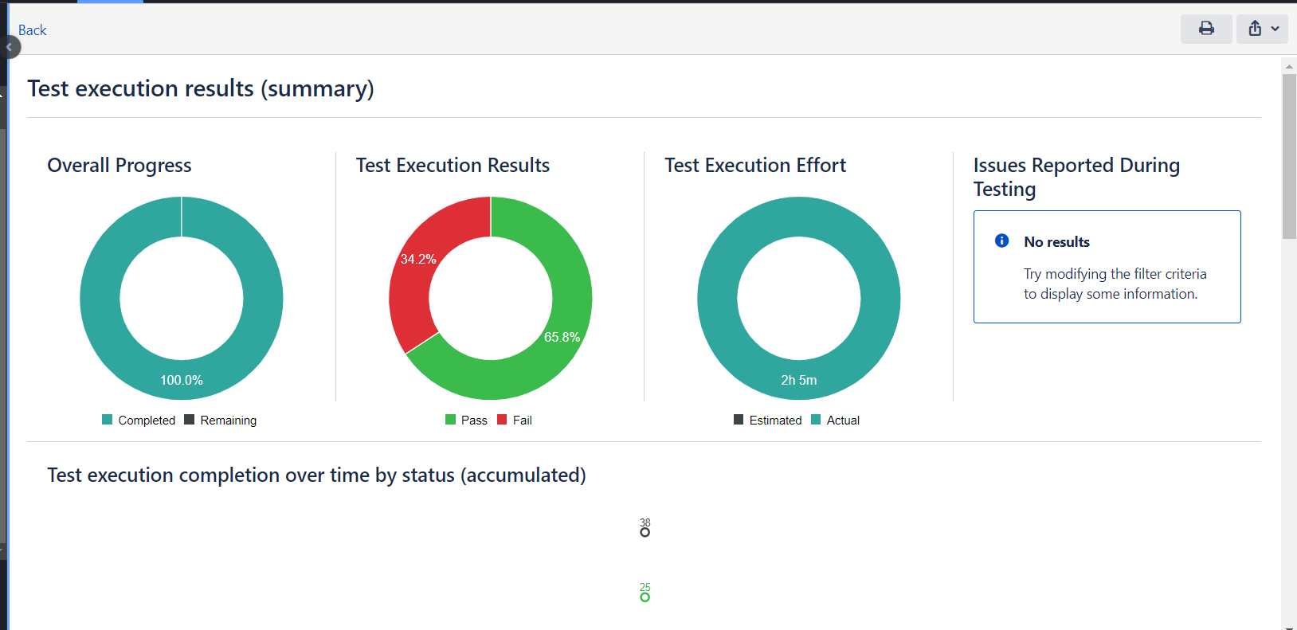

Slide 34
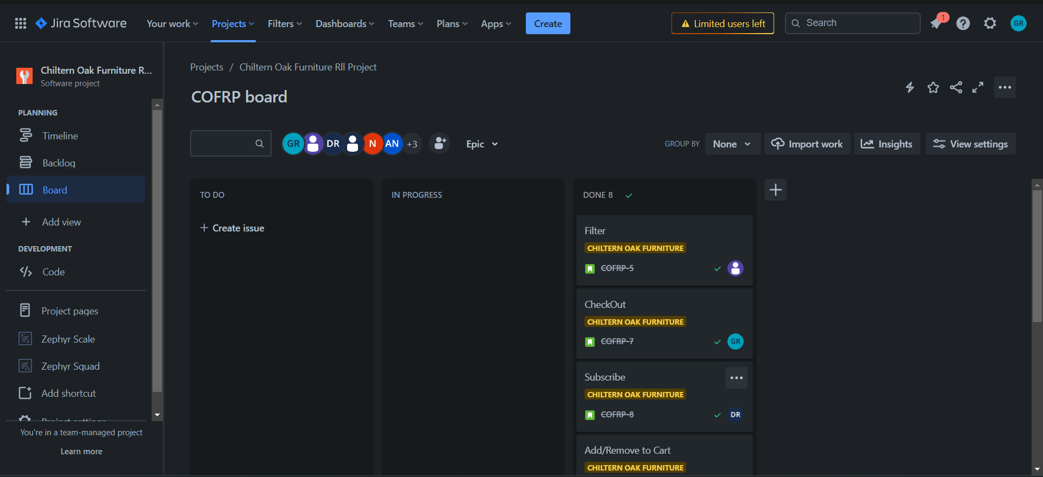

Slide 35
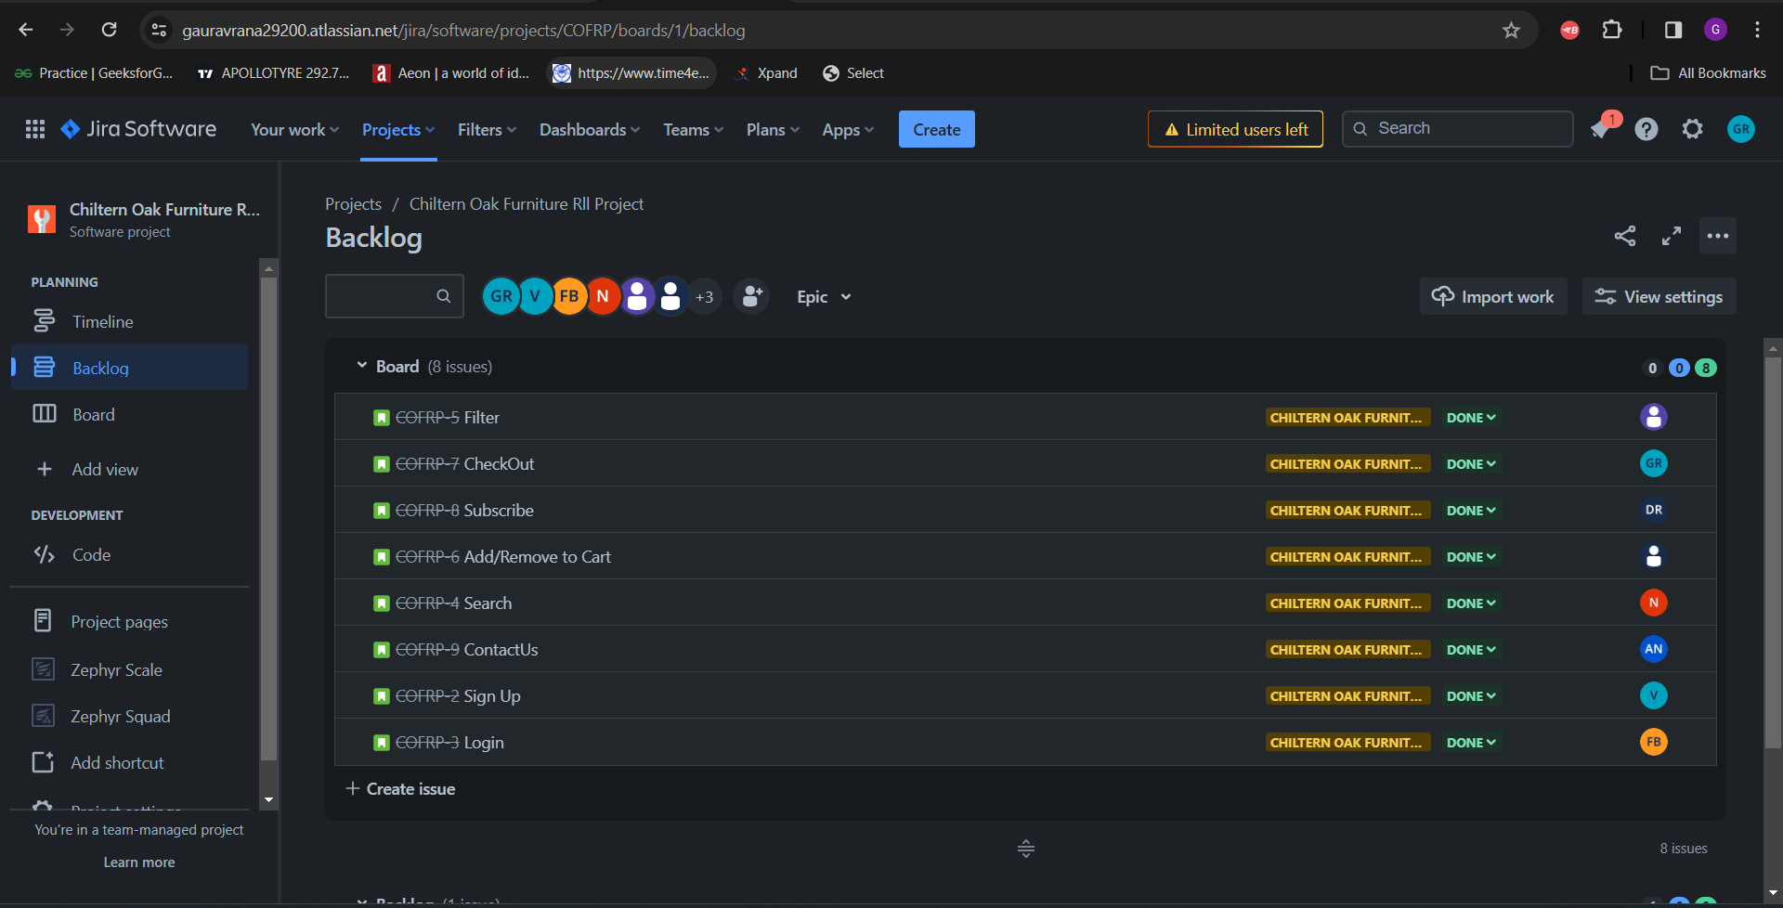

Slide 36
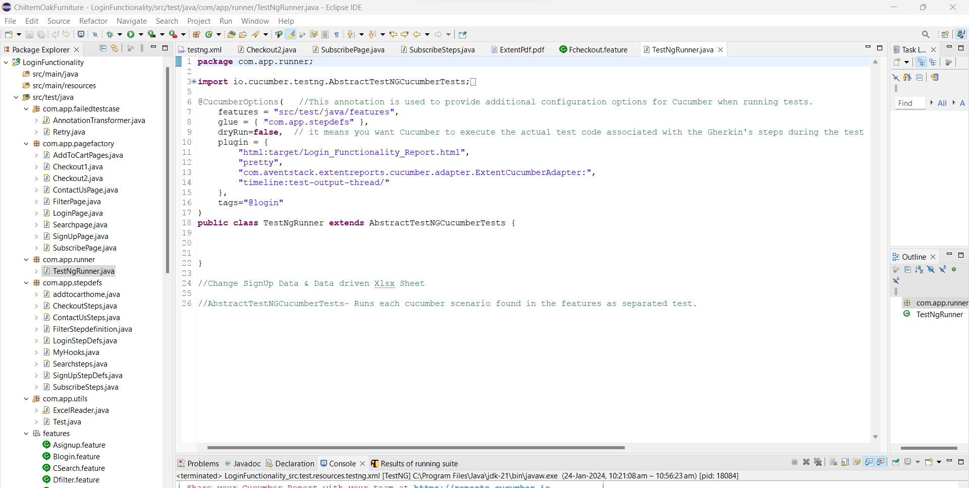

Slide 37
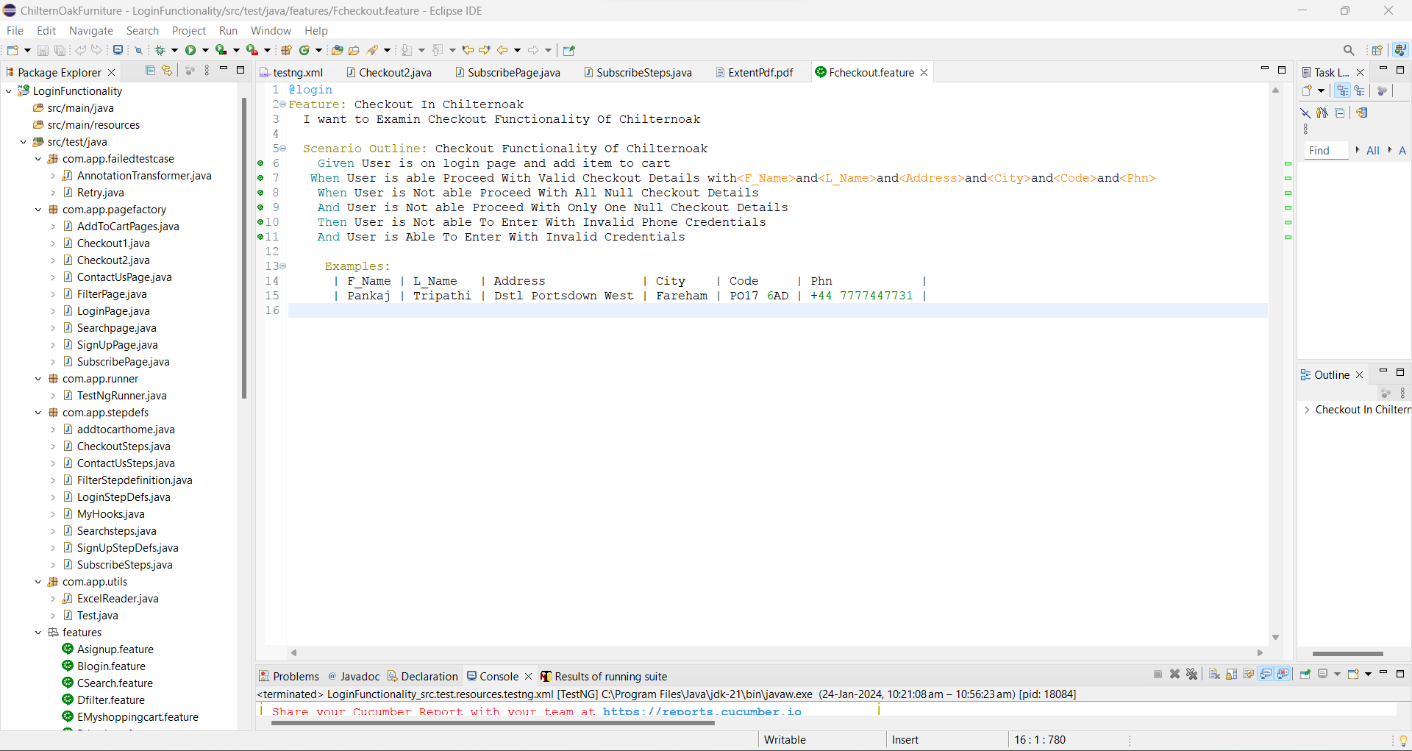

Slide 38
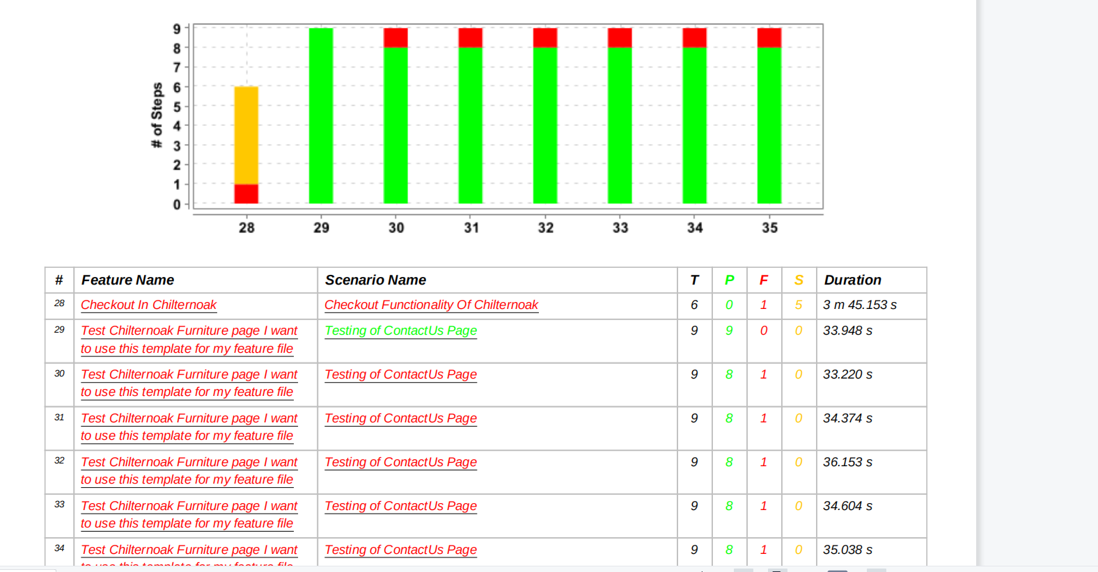

Slide 39
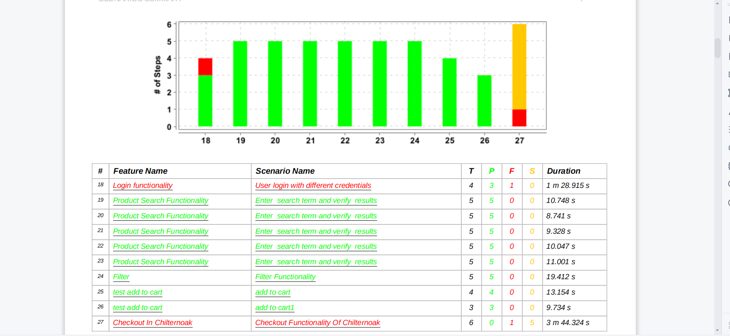

Slide 40
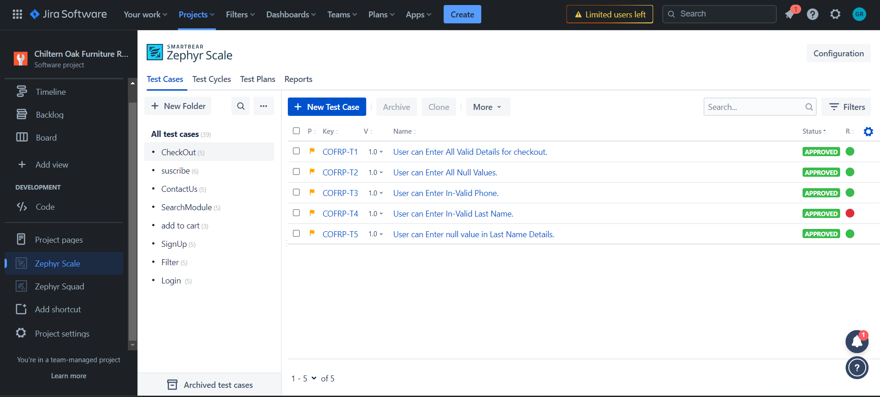

Slide 41
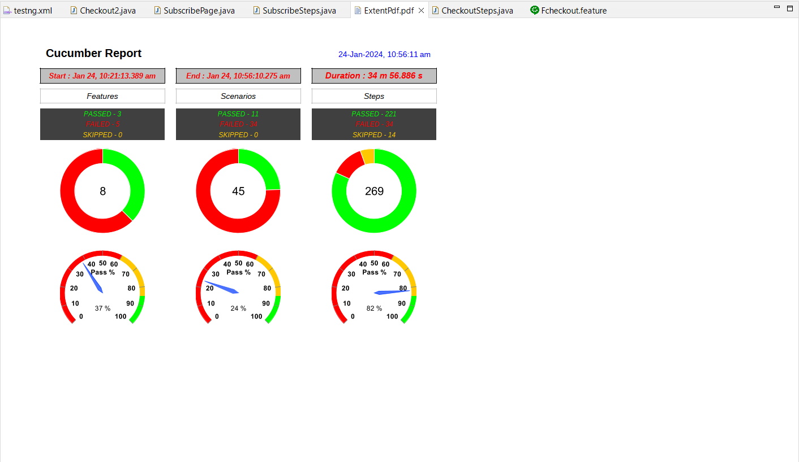

Slide 42
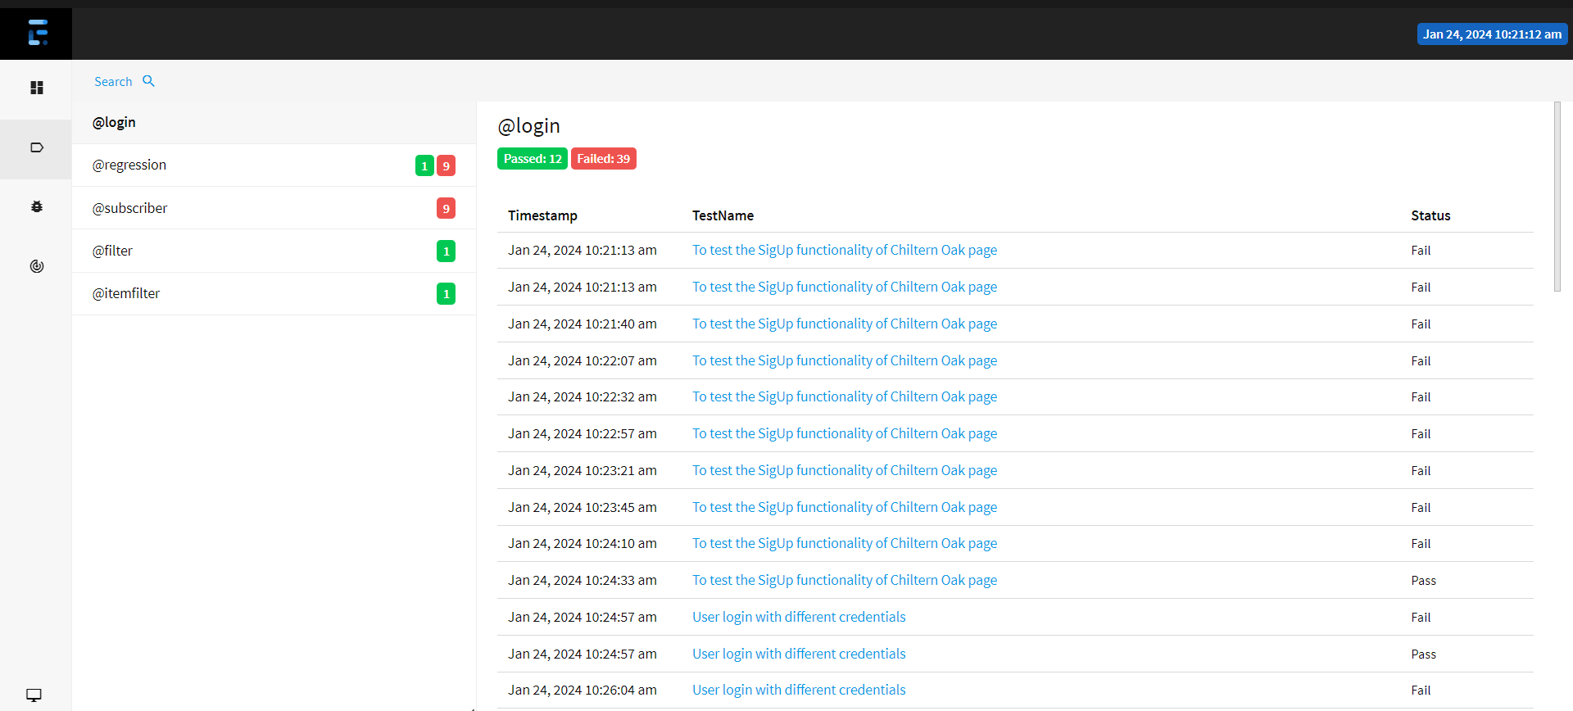

Slide 43
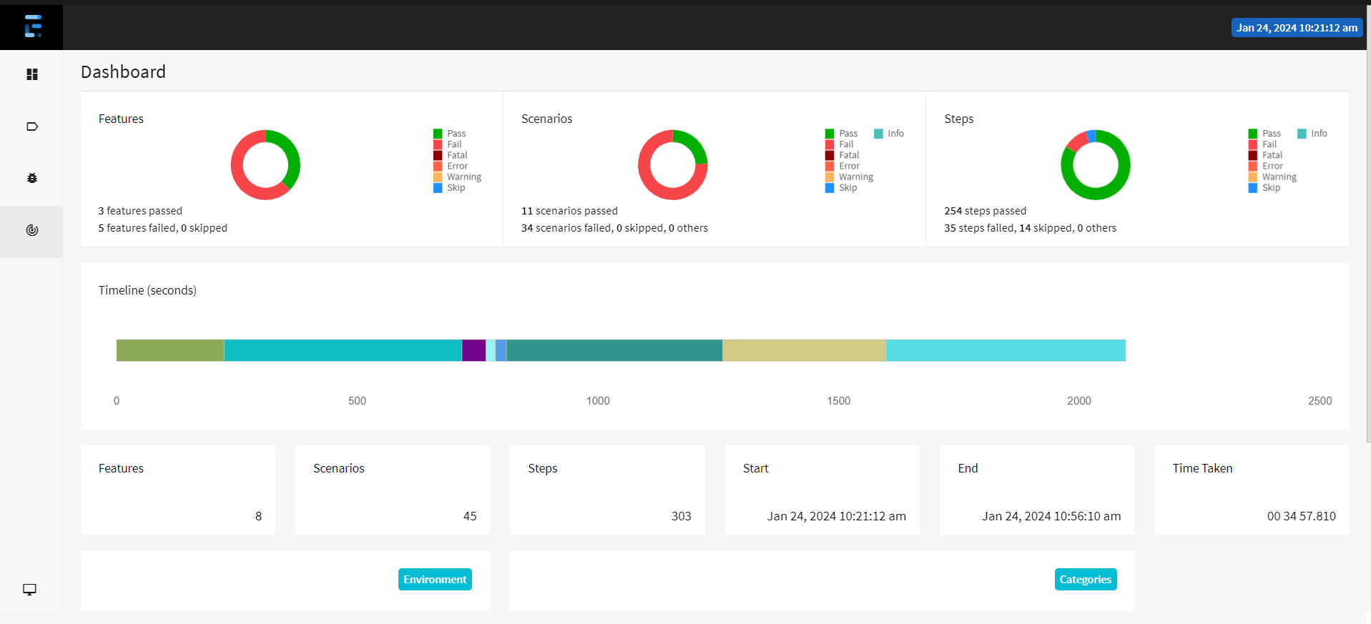

Slide 44
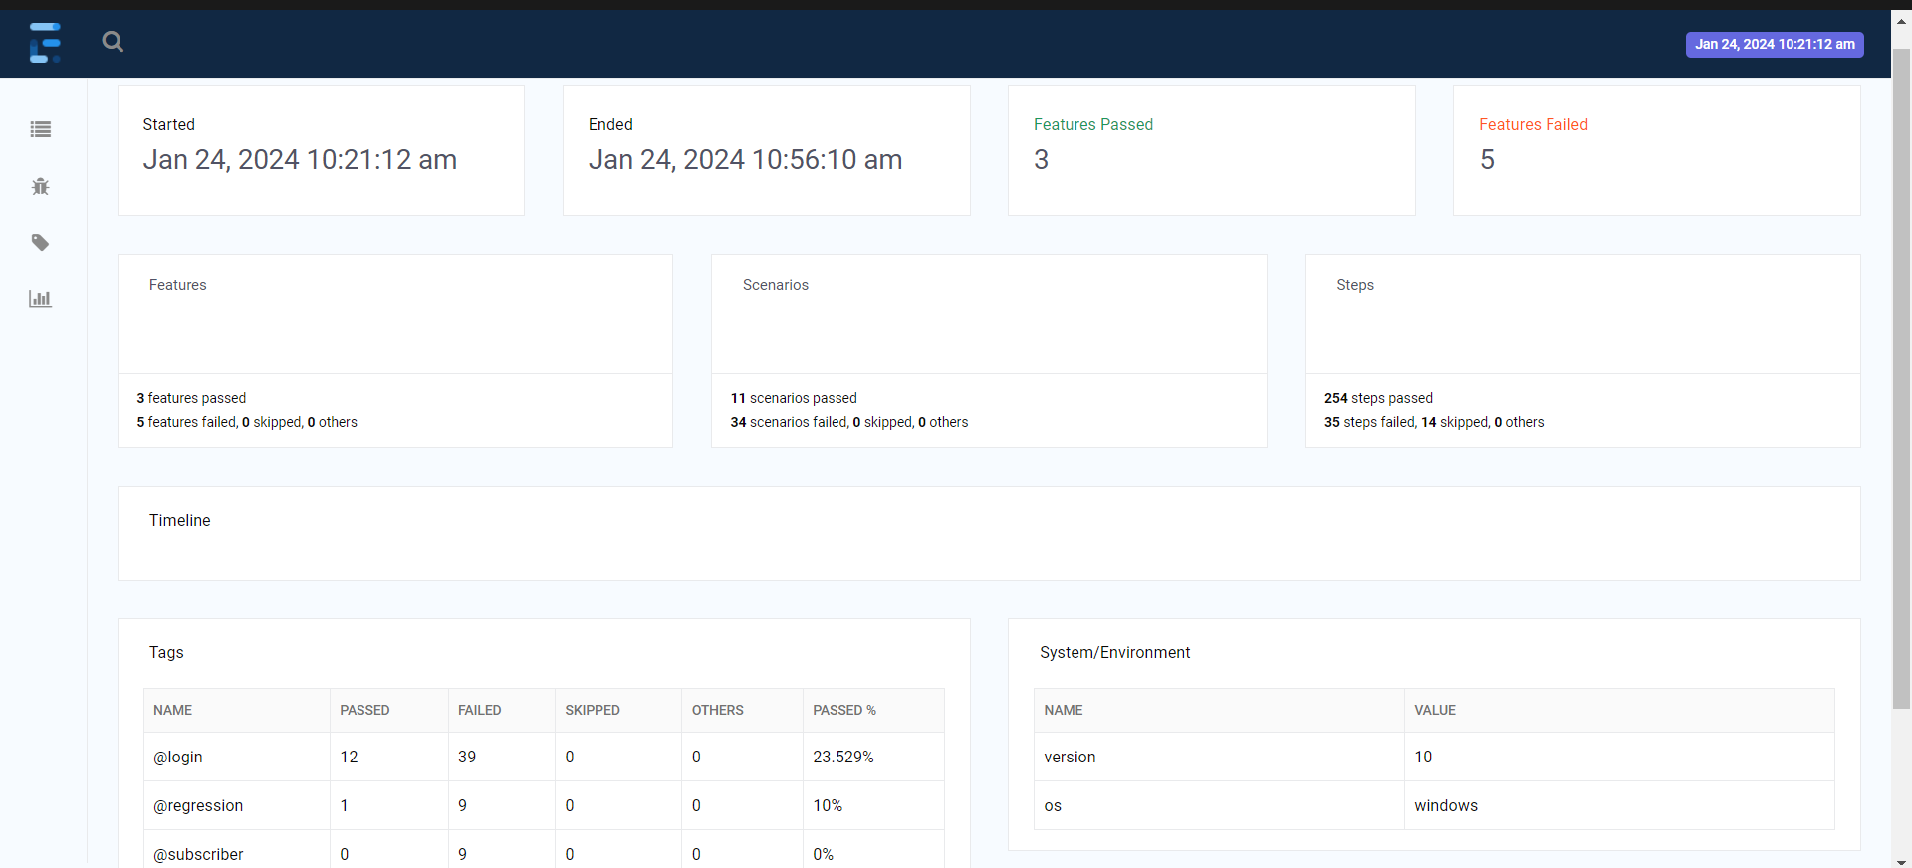

Slide 45
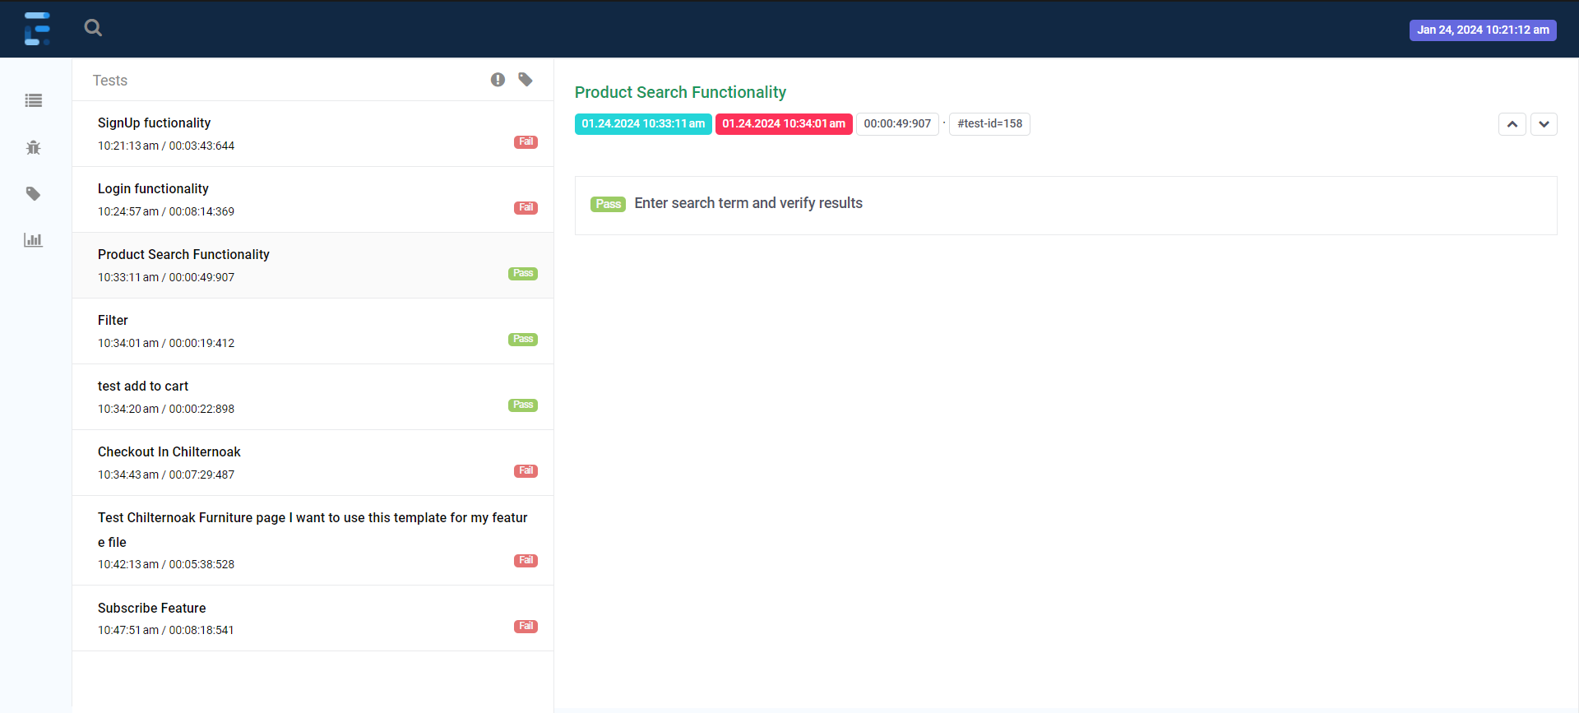

Slide 46
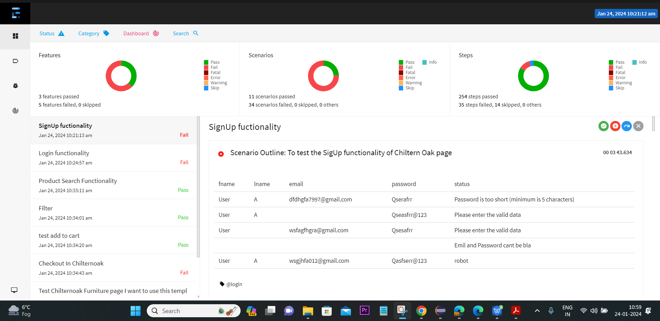

Slide 47
Conclusion
In summary, we've learned a lot about software testing and automation in this presentation. We started with the basics and talked about important tools like Selenium, Cucumber, and TestNG. We also looked at how the Page Object Model (POM) framework helps organize things better. Overall, we've covered the main parts that make testing smoother and better.

Slide 48

Thank you

